Slide 1



ADVANCED PUPPET
Deep Learning
Luís Algarvio
Luis.algarvio@syone.com

Slide 2

Puppet Basics

Slide 3

Puppet Basics
What is Puppet?
Tip: it's not a muppet!

Slide 4
Puppet Basics
What is Puppet?
Configuration management software
  ie, it is used for orchestration and automation
Uses Puppet declarative language
  and may use Ruby as well
Manages Unix-like and Windows systems
  including Debian, Ubuntu, CentOS, RHEL, SUSE, BSD and Mac OS X
Written in Ruby
  works best with Ruby 2.1.x for Puppet 4.x and 3.5+
Released as Puppet Open Source with Apache 2.0 License
  and Puppet Enterprise with commercial support
Developed by Puppet Labs

Slide 5

Puppet Basics
Modes of operation
The master, the agent and the ugly

Slide 6




Puppet Basics
Modes of operation
Server that compiles configuration for and manages clients.
Available as:
Puppet Server
Puppet Rack 1
Puppet WEBrick 1 2
1: deprecated
2: small infrastructure (10 nodes)
Standalone app that compiles and applies configuration locally.
It functions as both Server and Client, for the local node only.
It is also known as the User mode.
Available as:
Puppet Apply
Master
Client that applies configuration locally and is managed by a server.
Available as:
Puppet Agent
Agent
Apply

Slide 7

Puppet Basics
Installing...
Are we there yet?

Slide 8

Puppet Basics
Installing...
Methods of installation:
by Distribution repository (not recommended: outdated, no puppetserver package)
  CentOS 6 (Puppet 2.7.x) and CentOS 7 (Puppet 3.6.x) + EPEL
    yum install epel-release
    Agent: yum install puppet
    WEBrick (Master): yum install puppet-server
  Debian 7 (Puppet 2.7.x) and Debian 8 (Puppet 3.7.x)
    Agent: apt-get install puppet
    WEBrick (Master): apt-get install puppetmaster
    Rack (Master): apt-get install puppetmaster-passenger

Slide 9

Puppet Basics
Installing...
Methods of installation (cont.):
by Puppet Labs Packages repository (recommended: old stable)
  CentOS 6 and CentOS 7 (Puppet 3.8.x)
    see https://yum.puppetlabs.com/
    Agent: yum install puppet
    WEBrick (Master): yum install puppet-server
    Server 1.1.x (Master): yum install puppetserver
  Debian 7 and Debian 8 (Puppet 3.8.x)
    see https://apt.puppetlabs.com/
    Agent: apt-get install puppet
    WEBrick (Master): apt-get install puppetmaster
    Rack (Master): apt-get install puppetmaster-passenger
    Server 1.1.x (Master): apt-get install puppetserver

Slide 10
Puppet Basics
Installing...
Methods of installation (cont.):
by Puppet Labs PC repository (recommended: current stable)
  CentOS 6 and CentOS 7 (Puppet 4.2.x)
    see https://yum.puppetlabs.com/
    Agent 1.2.x: yum install puppet-agent
    Server 2.1.x (Master): yum install puppetserver
  Debian 7 and Debian 8 (Puppet 4.2.x)
    see https://apt.puppetlabs.com/
    Agent 1.2.x: apt-get install puppet-agent
    Server 2.1.x (Master): apt-get install puppetserver

Slide 11

Puppet Basics
Installing...
Methods of installation (cont.):
by Ruby Gems (custom deployments: current stable and any newer versions)
  see https://github.com/sstephenson/rbenv
  see https://github.com/puppetlabs/puppet
  see https://github.com/puppetlabs/puppet-server
  requires Ruby >= 1.9.3-p392
  Any OS with Ruby Gems (Puppet 4.2.x and newer)
    Agent: gem install facter puppet

Slide 12

Puppet Basics
Demo
Installing Puppet 4.2.x
`puppet help`

Slide 13
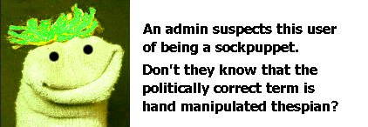
Puppet Basics
Terminology
The “mambo django”

Slide 14

Puppet Basics
Terminology
Backend
Environ
ment
Fact
Manifest
Catalog

Slide 15

Puppet Basics
Terminology
Backend
Used to provide third party integrations into Puppet.
They exist for different usage:
External Node Classifier (ENC), such as hiera-enc and foreman, to classify nodes by assigning them parameters and classes.
Pre-data, such as hiera-yaml, hiera-json, hiera-file and hiera-mysql, to store data and configuration.
Post-data, such as PuppetDB, to store facts, catalogs and reports about the nodes.
Backend
Environ
ment
Fact
3rdp
Manifest
Catalog

Slide 16

Puppet Basics
Terminology
Master
Environment
Isolated group that may be used for a DTAP workflow or split teams and / or an infrastructure.
Can hold distinct manifests, modules, templates, node definitions, data, configuration, etc..
Environ
ment
Manifest
File writen with the Puppet language (DSL), and a .pp file extension, that is used to generate a catalog for a node.
Can contain any number of resources, variables, classes, functions, types and nodes.
Required for creating a module or instanciating a class.
Backend
Fact
Manifest
Catalog

Slide 17

Puppet Basics
Terminology
Fact
Represents a piece of information that is known about a machine or node.
They are generated for the operating system, hardware, etc., and are used to build a catalog.
Available with:
Facter
Backend
Environ
ment
Fact
Agent
Catalog
Compilation of the final states of all the resources that are being managed for a given node.
As such, they contain no conditional logic, functions or code.
Manifest
Catalog

Slide 18
Puppet Basics
Terminology
Master
Backend
Environ
ment
Fact
3rdp
Agent
Manifest
Catalog

Slide 19

Puppet Basics
Workflow
From REST to Bucket
`puppet agent --test`

Slide 20





Puppet Basics
Workflow
Master
Update Master
Sends facts and last catalog
Agent
Update Agent
Sends the new catalog
Facts
Apply changes with Agent
Applies the catalog locally
Config
Update?
Update Master
Sends the report
Data
Compile
Catalog
Code

Slide 21

Puppet Basics
Managing Environments
Enter Librarian Puppet (librarian-puppet)

Slide 22
Puppet Basics
Managing Environments
“Bundler” tool for Puppet. Forget “puppet module” subcommand
  ie, it is used to manage modules. Don't hack them!
Dependency and version based
  follows listed dependencies and installs the specified versions
Can use custom repo and multiple sources for modules
  use Puppetlabs Forge or a custom Pulp forge for the repository
  modules may be used from the forge, git repos, tarbals, etc
Can support multiple environments
  create a librarian-puppet Puppetfile per environment
Can be used together with Git or other SCM
  revision control the environments, with or without the module code

Slide 23
Puppet Basics
Managing Environments
Method of installation:
by Ruby Gems
  see https://github.com/rodjek/librarian-puppet
  requires Ruby >= 1.9.3-p392
  Any OS with Ruby Gems (Librarian Puppet 2.1.0)
    gem install librarian-puppet -v 2.1.0

Slide 24
Puppet Basics
Demo
Installing Librarian Puppet
`librarian-puppet init`

Slide 25
Puppet Backends

Slide 26
Puppet Backends
Reminder.
There are three kinds of backends:
Pre-data
  hiera-yaml & hiera-json
  hiera-file
  hiera-mysql
  etc
External Node Classifier (ENC)
  hiera-enc
  foreman
Post-data
  PuppetDB
  foreman

Slide 27

Puppet Backends
External Node Classifier
Classifies somethin' with somethin'

Slide 28
Puppet Backends
External Node Classifier
Replaces the limited Node Definitions in the Environment's manifests
Normally knows the nodes
  ie, the nodes have previously been inserted to it (perhaps before cert sign)
  else, it will guess what is best for them, with the fabulous defaults
Defines the Environment for the node
  no matter what environment the node asks, the master will prevail
Provides the initial Parameters for the node
  which can be further used by Manifests and Hiera
Attributes the initial Classes for the node
  who in turn can be fed Parameters by the ENC, Manifests and Hiera
Complicated huh? Flexible too!

Slide 29
Puppet Backends
Demo
Installing an ENC: hiera-enc
`hiera-enc <node_name>`

Slide 30

Puppet Backends
Pre-data backend
Feeds Puppet before it can begin

Slide 31
Puppet Backends
Pre-data backend
Replaces the limited Node Definitions in the Environment's manifests
Allows for reusage or configuration and data
  ie, no more repeating the same steps for each node
Allows for hierarchisation of your infrastructure
  consider that the node may inherit configuration from it's parents, such as hostgroup, network, location, organization, etc
Allows using Facts and Parameters
  which means that the configuration is actually dynamic
Fallsback to defaults
  in any case the defaults can be supplied
We have a more interesting picture now.

Slide 32
Puppet Backends
Demo
Using a Pre-data backend: hiera-yaml
`hiera_include('classes')`

Slide 33
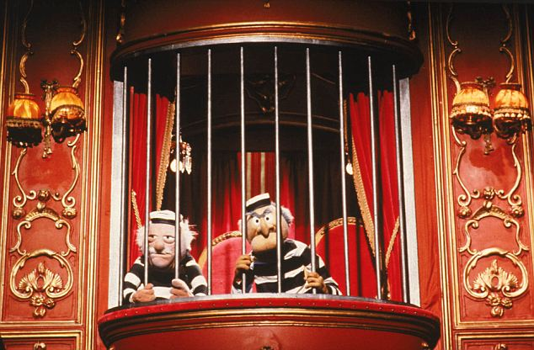
Puppet Backends
Post-data backend
They all have to go somewhere after

Slide 34
Puppet Backends
Post-data backend
Replaces the traditional filedump storage in Puppet
Data can be stored in one central place
  avoid the master and the agent from dumping facts, catalogs, graphs and reports
Consult the changes interactively
  and reverse them when needed
See the statistics for your infrastructure
  to find out compilation times, applying times, failture rates, etc
Plus all those pretty graphs
  It's also a reporting tool afterall
So this means we get to use a UI as well.

Slide 35
Puppet Backends
Demo
Installing a Post-data backend: PuppetDB
`puppetdb help`

Slide 36
Puppet Code

Slide 37

Puppet Code
Modules and Classes
Classing all the modules

Slide 38
Puppet Code
Modules and Classes
Modules are meant to implement code for a specific purpose
  yet they should be as much generic as possible, that is, contain no specific node configuration (except in very extreme scenarios)
This way they can be applied to as many nodes as possible
  which means that naturally you will have less specific code to maintain
Must contain a minimum set of files to work
  this includes the init.pp and metadata.json
Must contain at very least one class to work
  this class name is normally the name of the module
May contain additional files to have extra functionality
  such as additional classes, templates, ruby functions, custom facts, etc

Slide 39
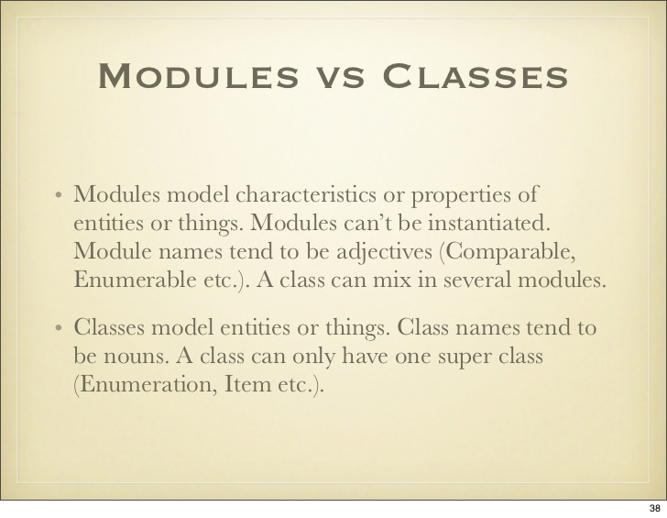
Puppet Code
Modules and Classes

Slide 40
Puppet Code
Modules and Classes
Classes are meant to be instantiated as required
  so their code is guaranteed to work with any set of parameters
Code can be split by context or functionality subset by using classes
  a params class is used to manage parameters, may have a install class, etc
Parameters inside a class can be overriden when instanciating
  which is why we can provide configuration when applying a module
But like variables in any Manifest, they can not be altered
  so once instanciated, no more editing. But you can read and re-instanciate
We use classes to actually load a module
  and we can load classes in the ENC, in Hiera and in Manifests

Slide 41
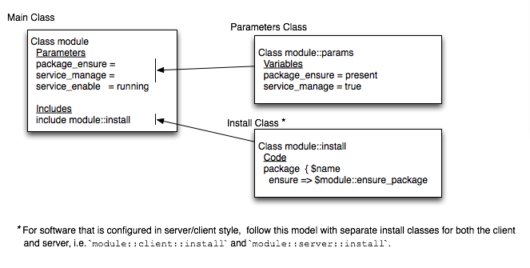
Puppet Code
Modules and Classes

Slide 42
Puppet Code
Demo
Building a marvelous module...
`puppet module generate`

Slide 43

Puppet Code
Ruby in Puppet unleash the metal in you!

Slide 44
Puppet Code
Ruby in Puppet
Ruby code can be used to make puppet more powerful
  but it's use is limited to custom functions, custom facts and templates
Can make use of ruby gems and puppet functions
  which means we can use hiera, hiera_lookup, etc ;)
Custom functions can be called in Manifests
  and in any manifest, so that means we can call functions from any module
Custom facts get loaded by Puppet
  and are then distributed to nodes, to be able to produce facts
Templates describe files that are going to be created
  and can include in them ruby code and variables to be dynamic

Slide 45

Puppet Code
Demo
Writing some magic...
`facter help`

Slide 46
Luís Algarvio
Luis.algarvio@syone.com

